Slide 1

PYTHON CHALLENGE
DAY 9
By
Laxmi Prasanna Gandham

Slide 2
Today Topics: Inheritance & Polymorphism
Inheritance:
Inheritance allows a class (child/subclass) to inherit properties and behaviors (attributes and methods) from another class (parent/superclass).
It helps in code reuse and represents "is-a" relationships.
Example: Electric Car is a type of Car.
Polymorphism:
Polymorphism means "many forms". In OOP, it allows different classes to use the same method name with different behavior.
It’s often seen in method overriding, where a subclass changes the behavior of a method from its superclass.
Example: Both Car and ElectricCar have display_info(), but ElectricCar shows extra info.

Slide 3
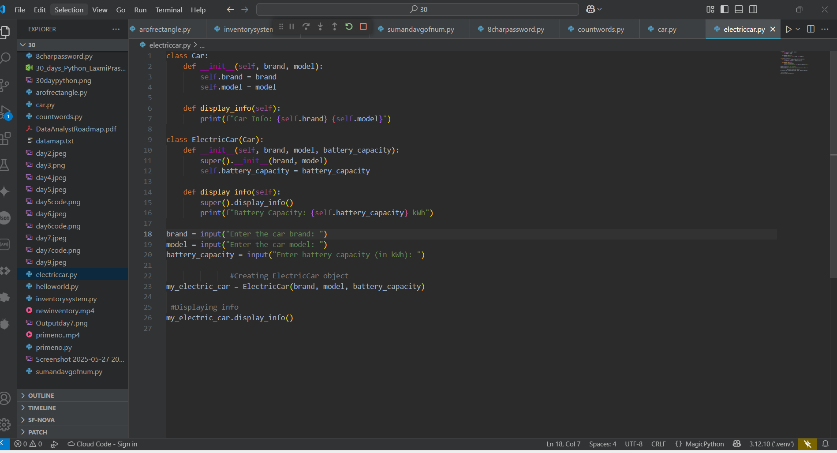
Challenge: Extend Car into an ElectricCar subclass with battery capacity

Slide 4
Code Explanation:
Car class defines brand and model attributes, and a method to display them.
Electric Car extends Car and adds a new attribute: battery-capacity.
It uses super() to call the parent’s methods and reuses code efficiently.
User inputs are taken to create an Electric Car object, and its full details are displayed.

Slide 5
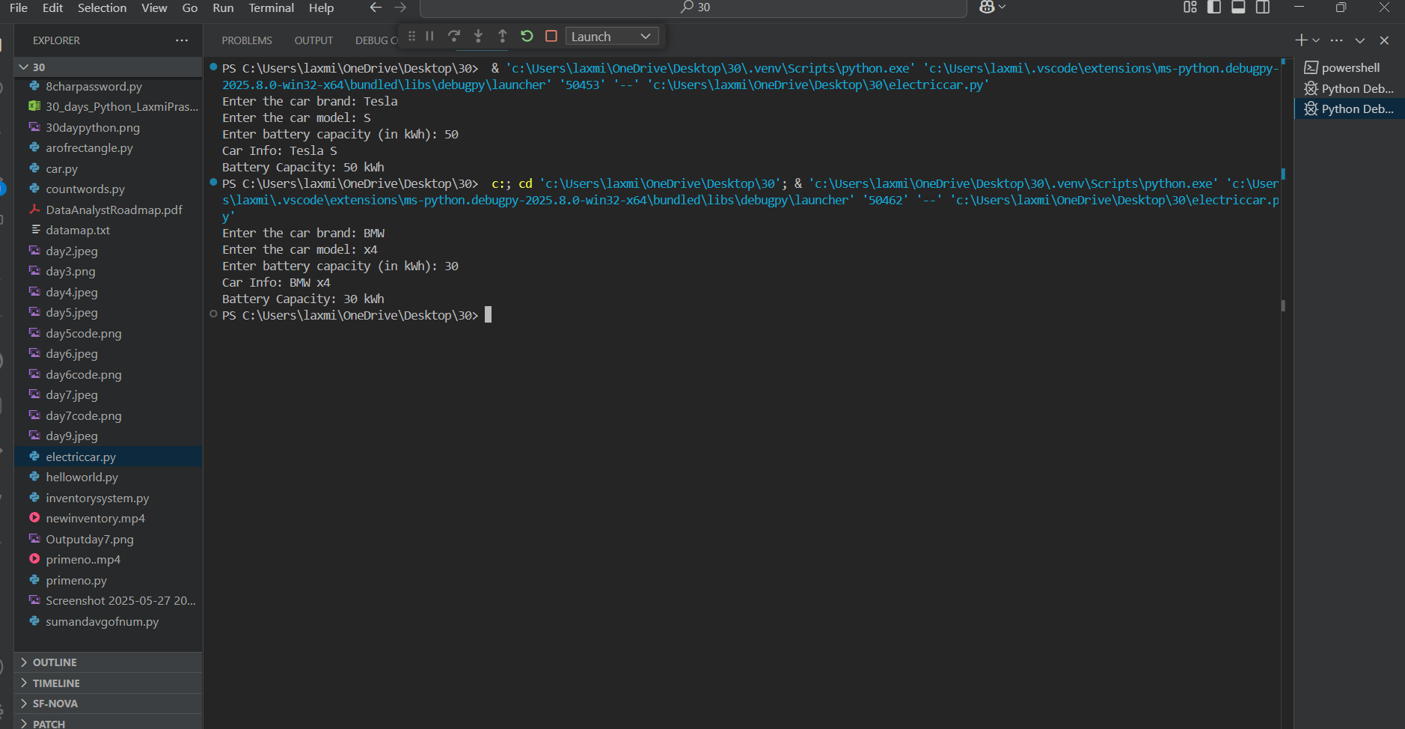
Output
Thank You

